Slide 1
LE26-116 What's new: Enhanced document reporting
Kennie Nybo Pontoppidan
Mirko Biasini

Slide 2
Business Value
More effective design of document reports
UX improvements to the Word add-in and report datasets
More effective document management
Layout lifecycle
Easier support for multi-language companies
New company default for document language
Open up for even more automation
Get PDF for all document types
Notes:
LE25-100

Slide 3
Enhanced document reporting (highlights)
Updated Word add-in
Lifecycle status for layouts
Company-level default language
Tooltips on table fields
Modernization of report selection pages
New APIs for document reports

Slide 4
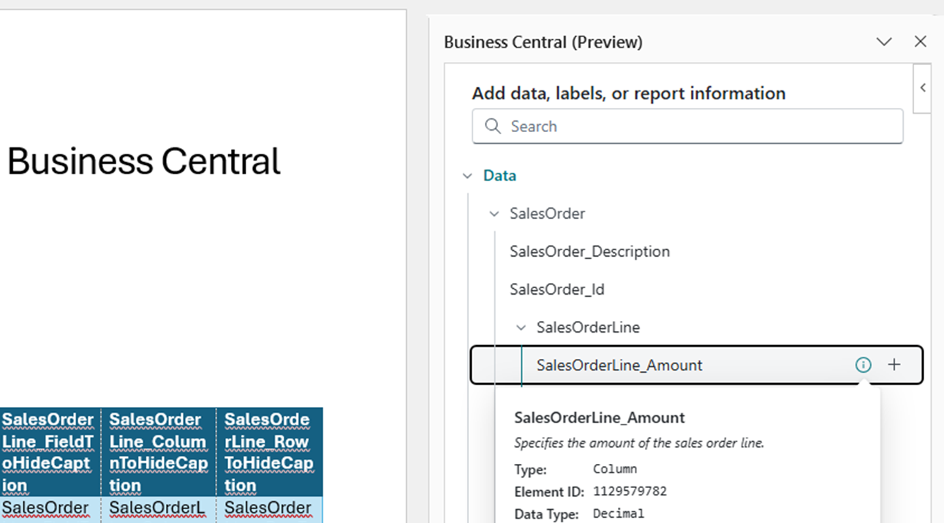
Updated Word add-in
Enhanced UX for data picker
Search in data fields
Table builder (preview)

Slide 5


Slide 6
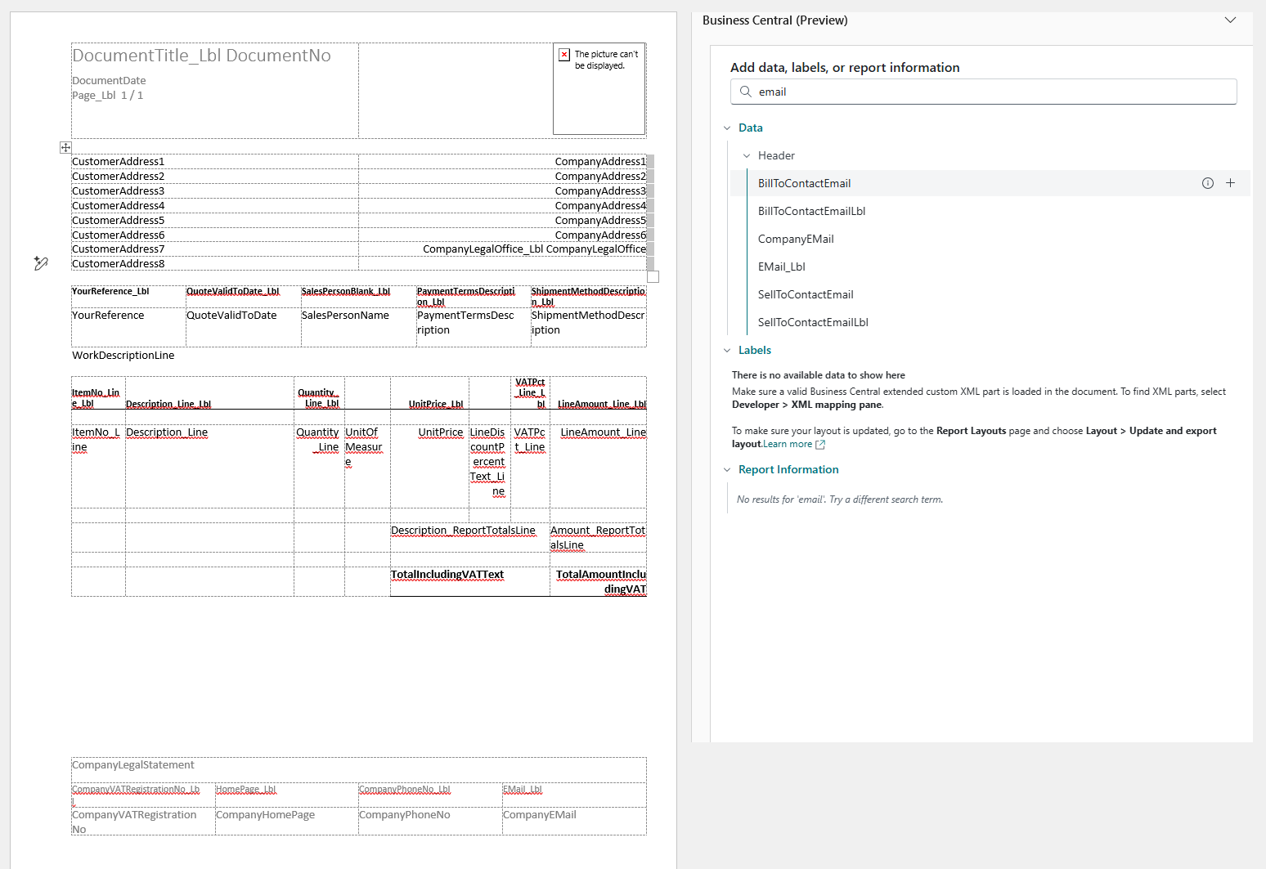

Slide 7
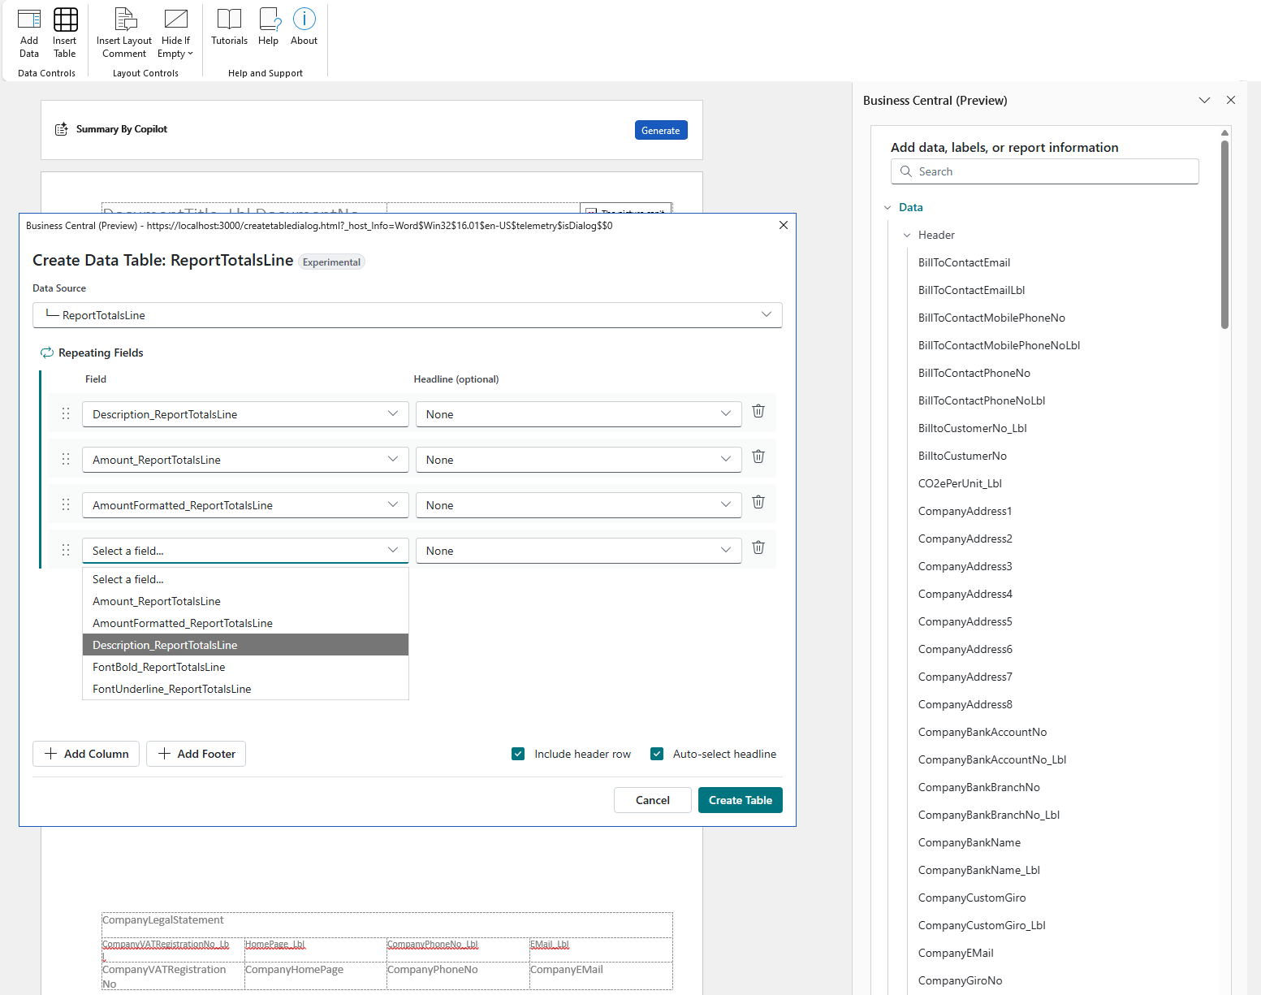

Slide 8
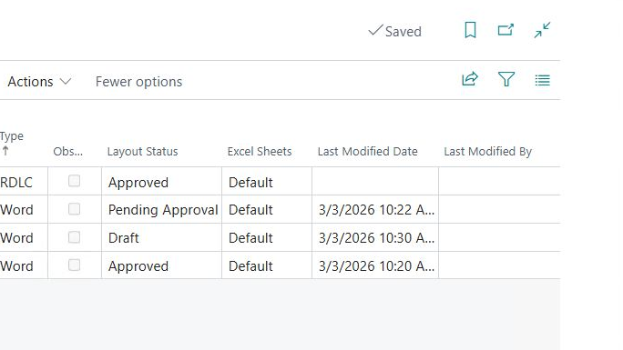
Lifecycle status for layouts (28.x)
Define which layouts are active,
which ones are in draft,
and which ones are retired.

Slide 9
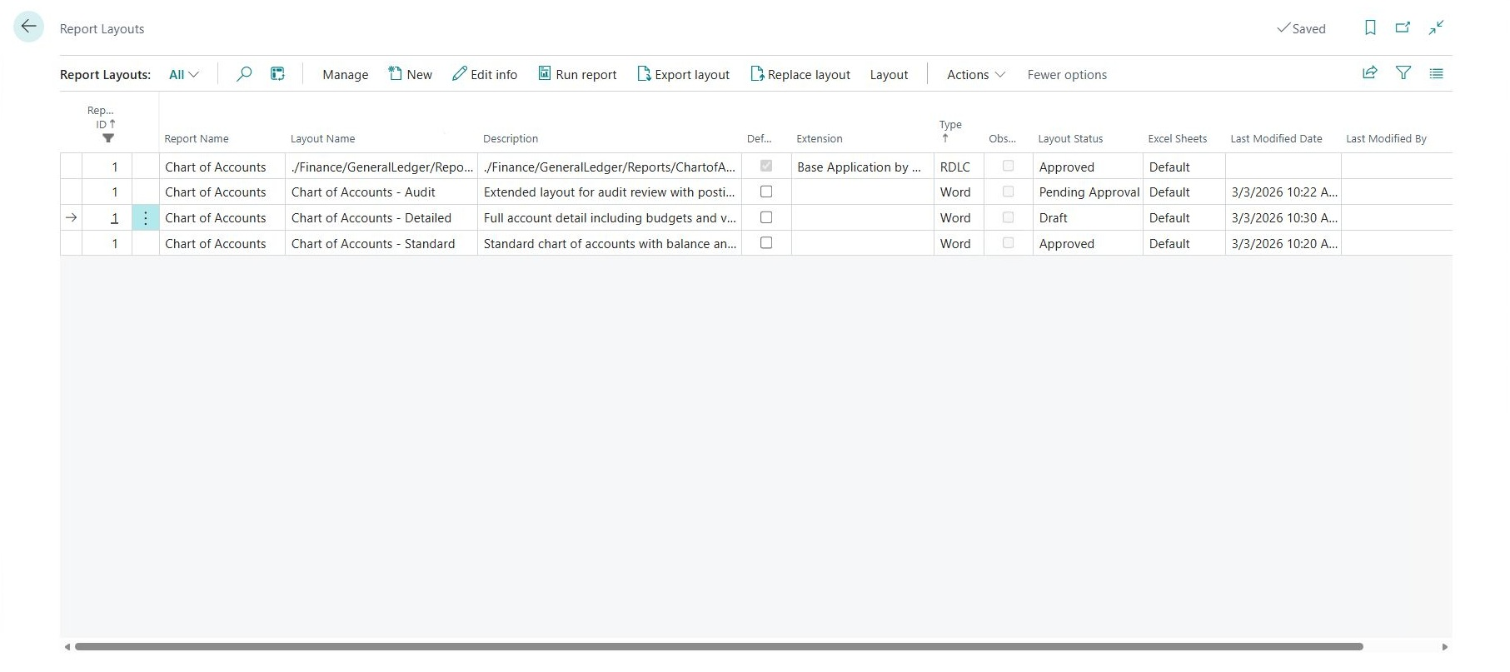

Slide 10
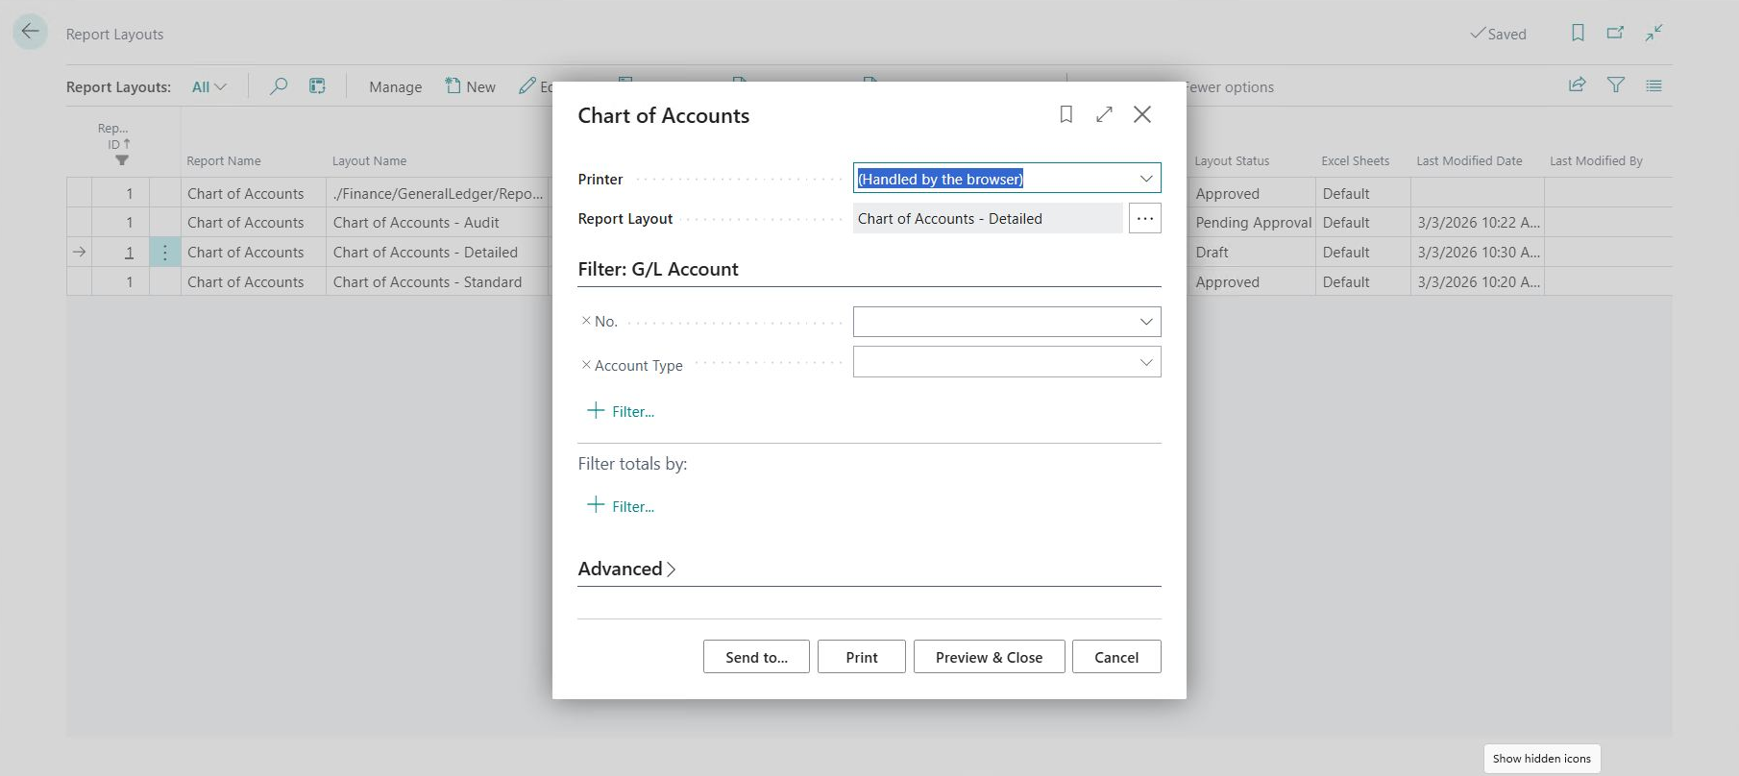

Slide 11
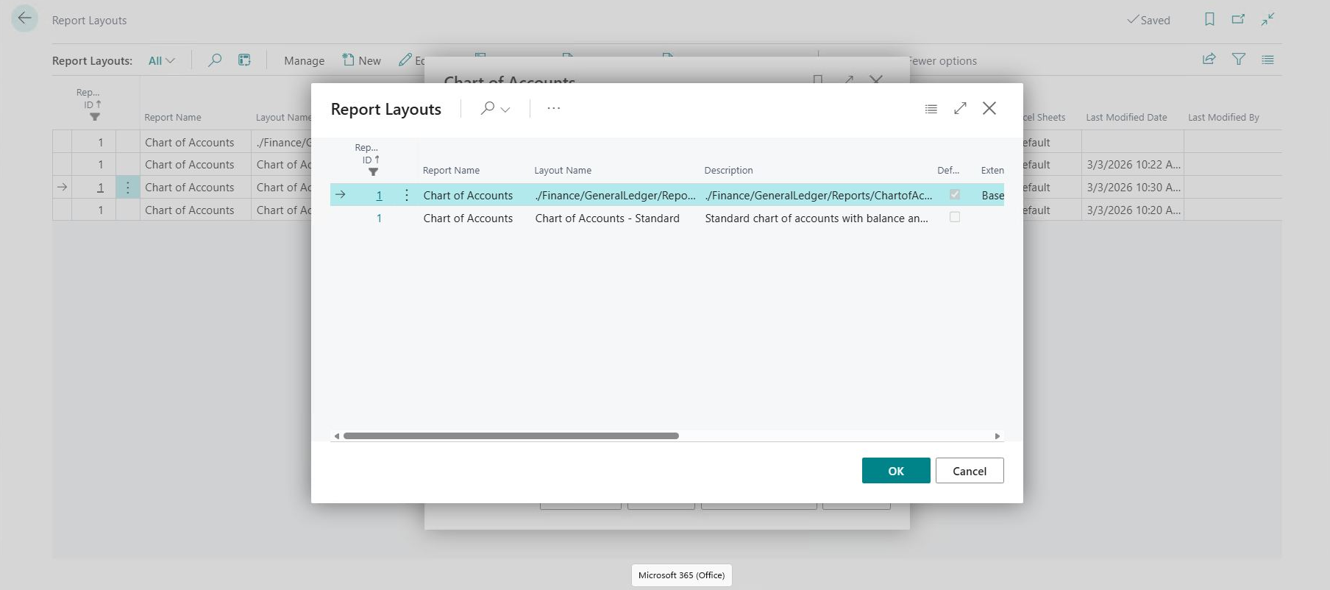

Slide 12
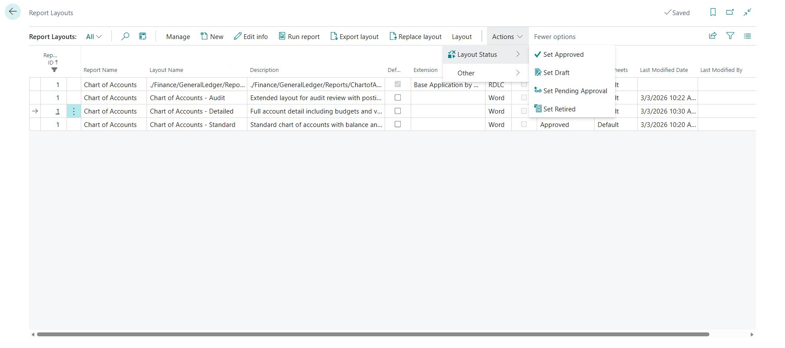

Slide 13
Note!
Lifecycle only works for user-defined layouts (for now).

Slide 14
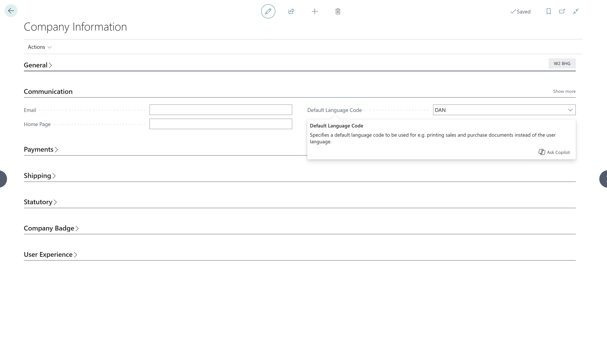
Company-level default language
You can now define a default language for document reports

Slide 16
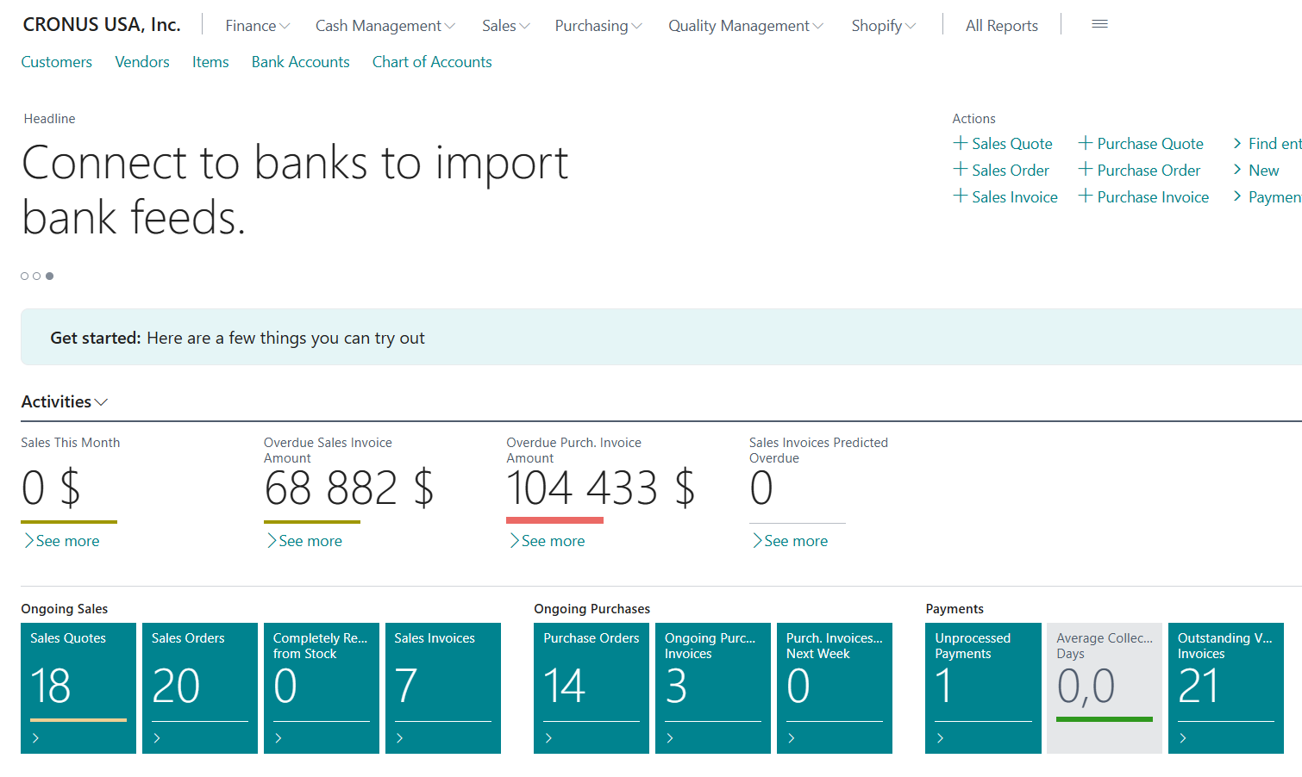
Everything here is US English

Slide 17
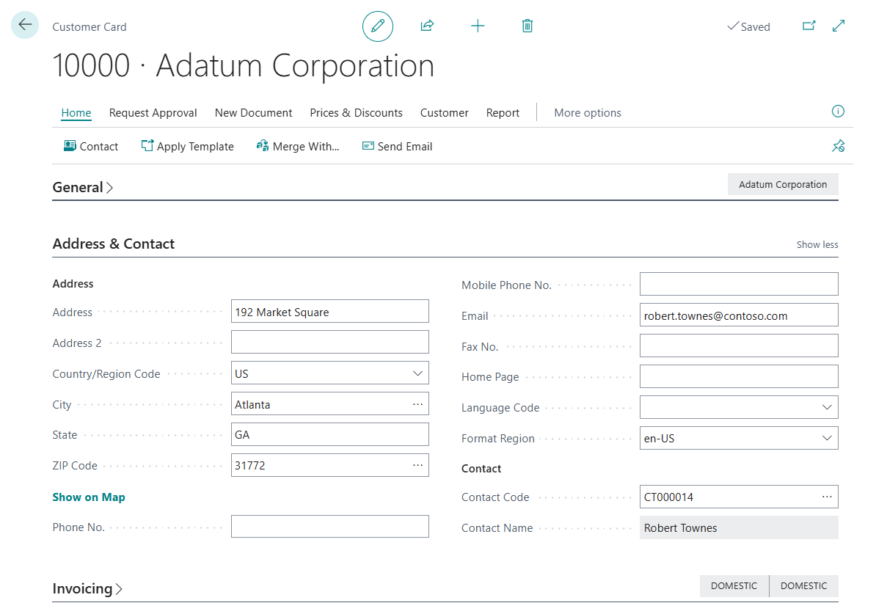
On the Customer card

Slide 18
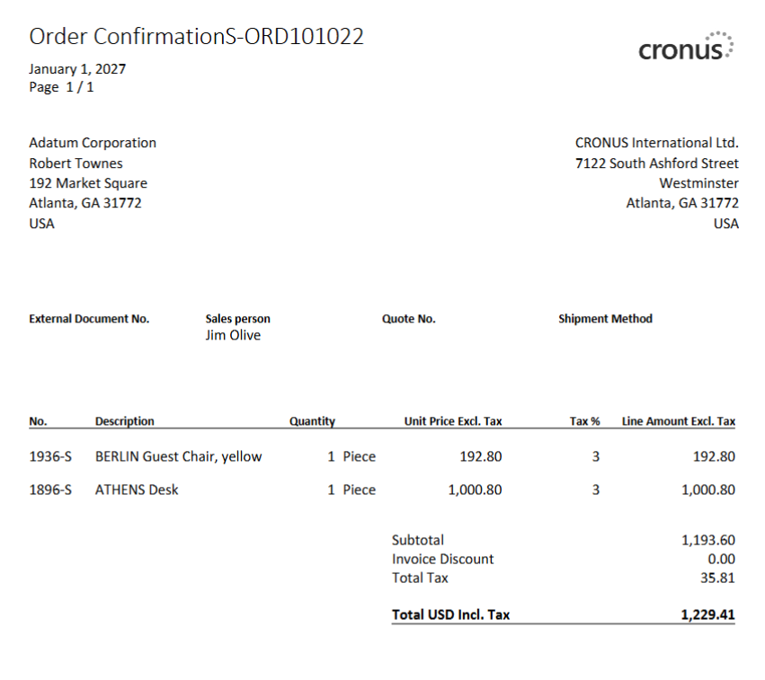
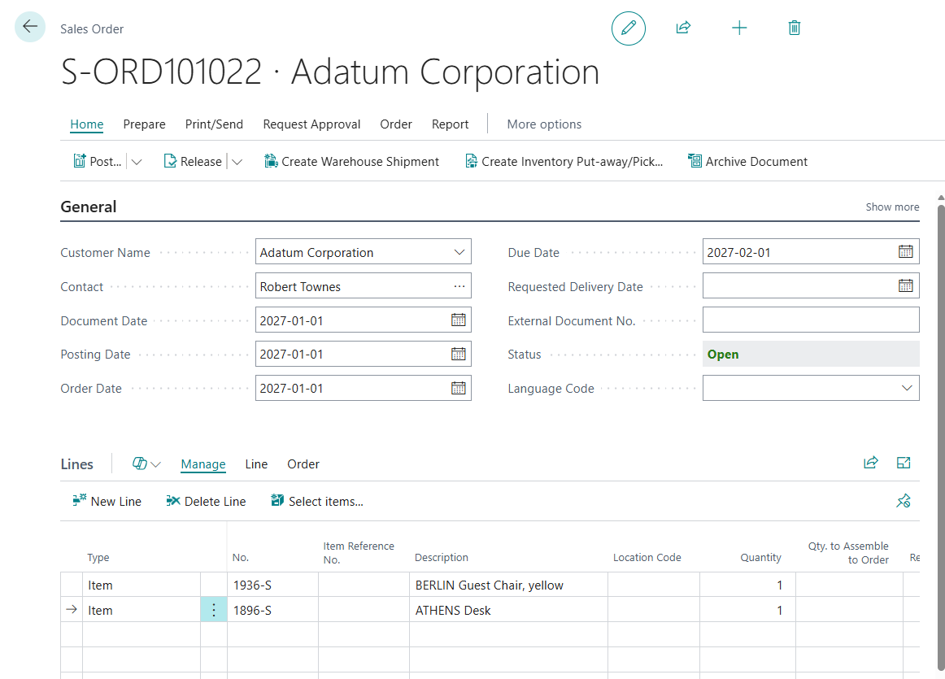
New Sales Order

Slide 19
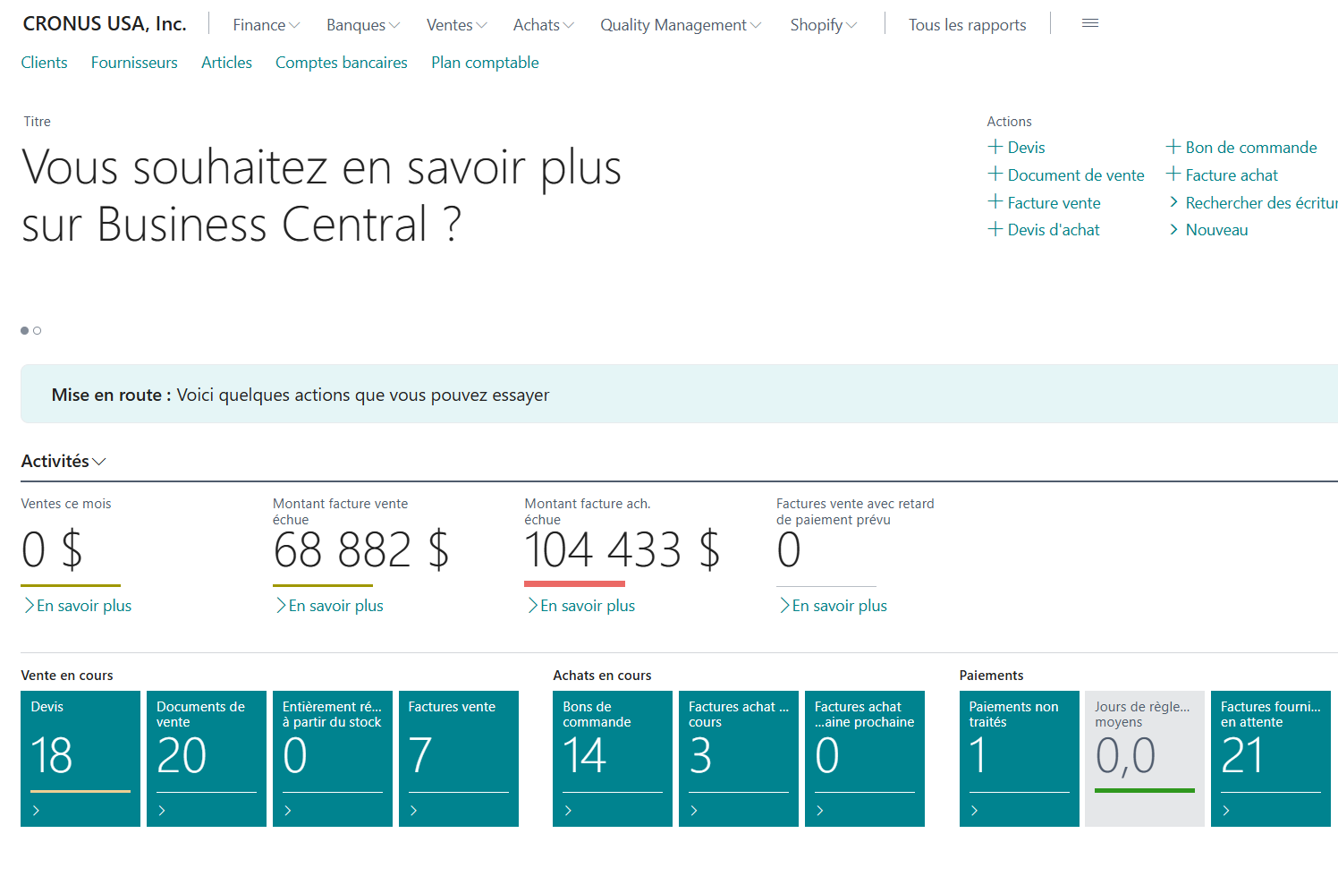
UI is Canadian French

Slide 20
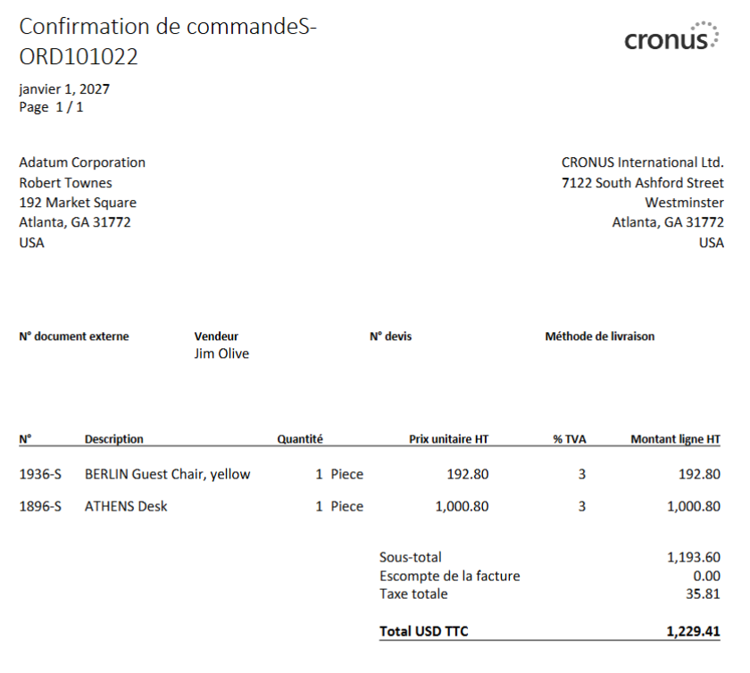
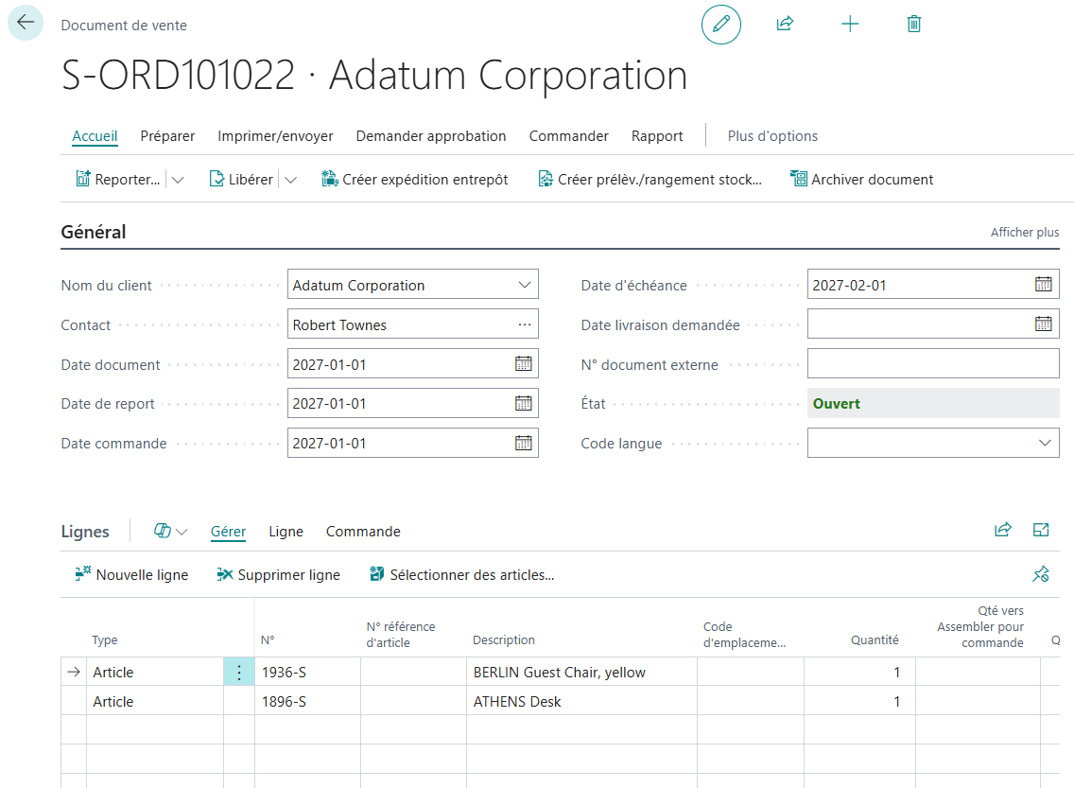
Now the customer gets their document in French!!!

Slide 21
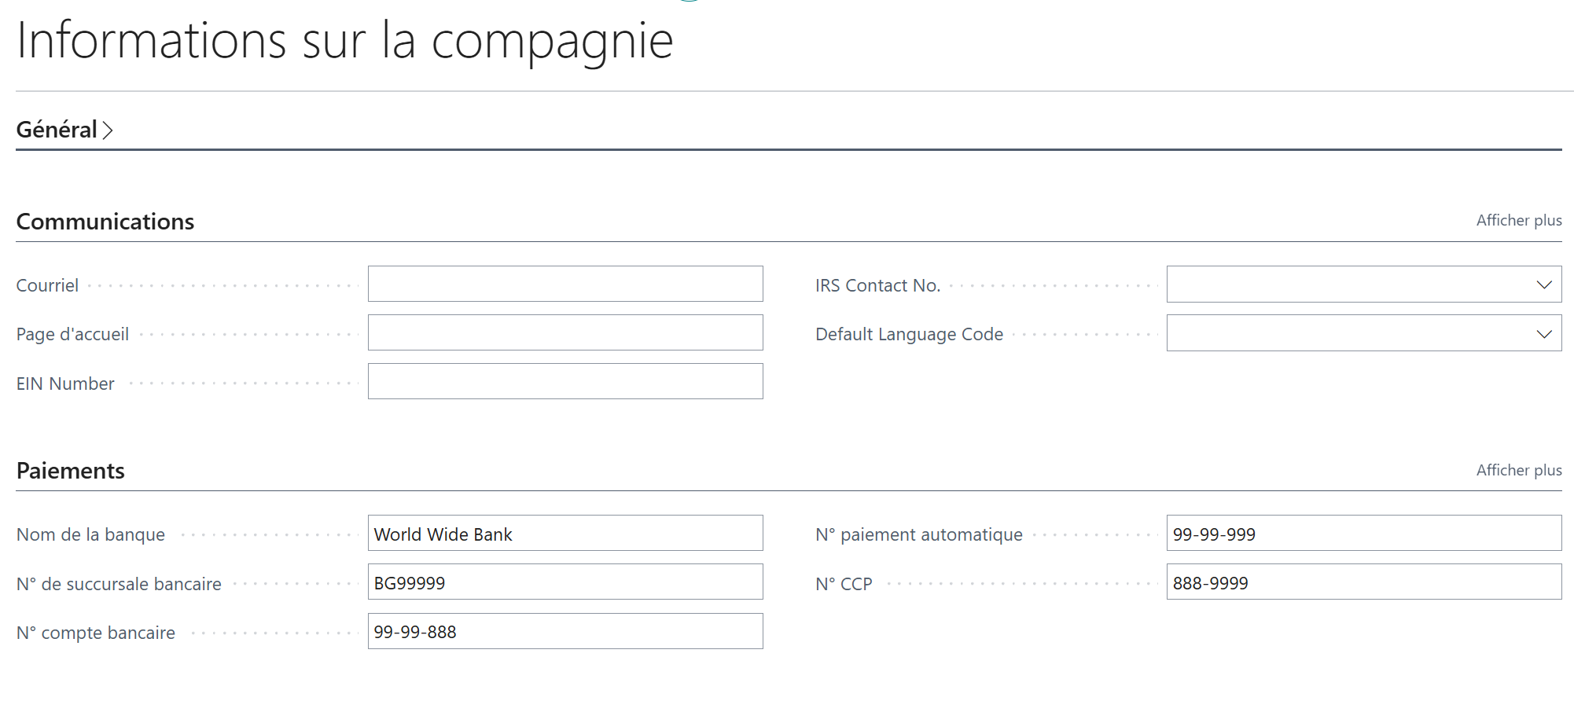
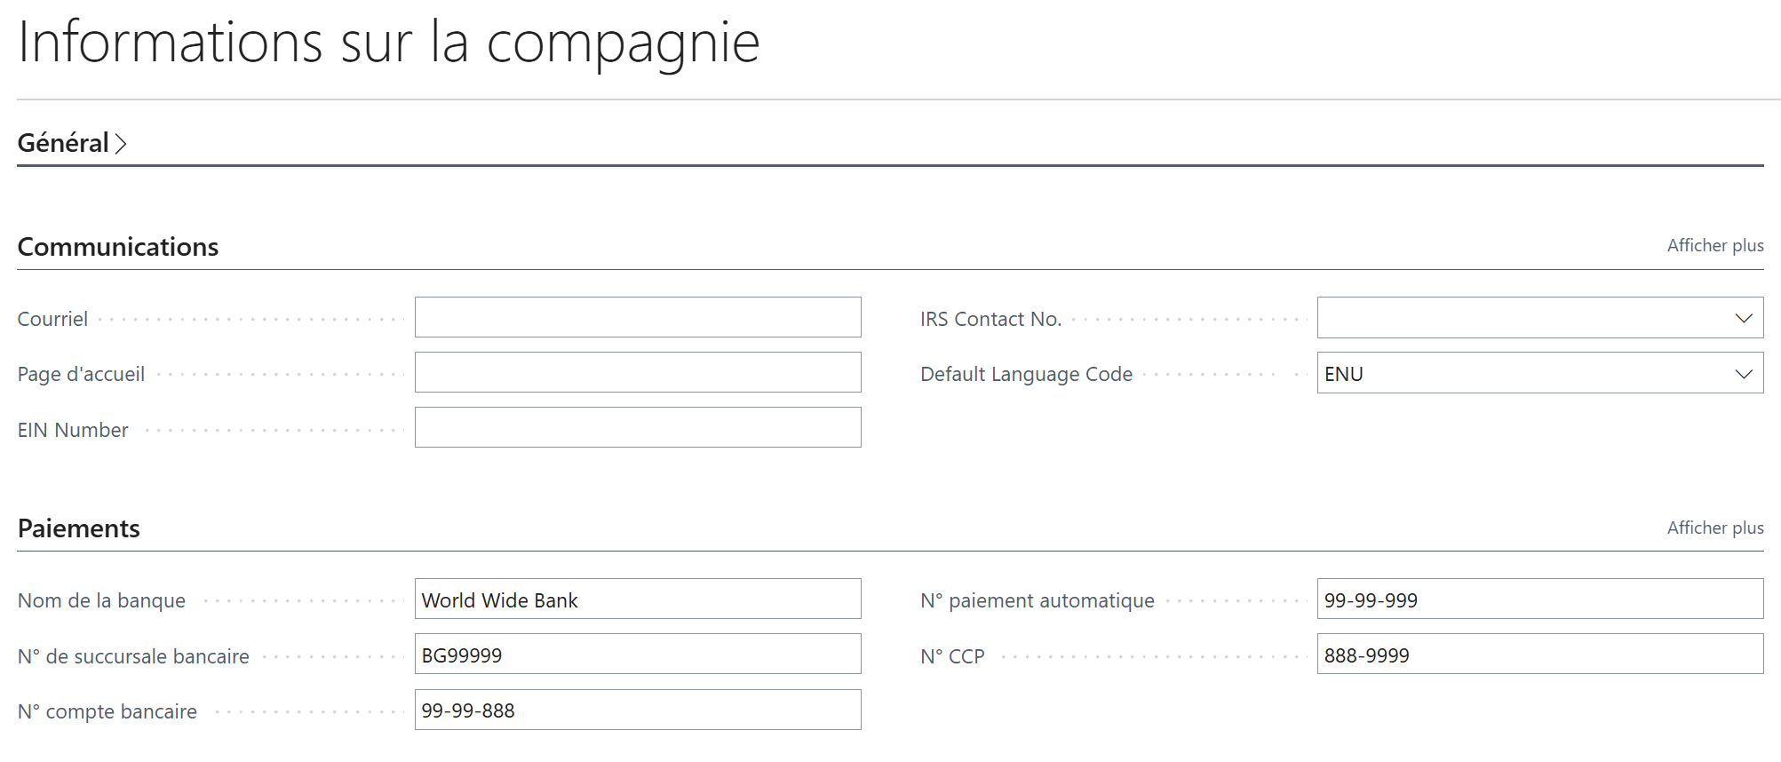
New: Default company-level Language Code

Slide 22
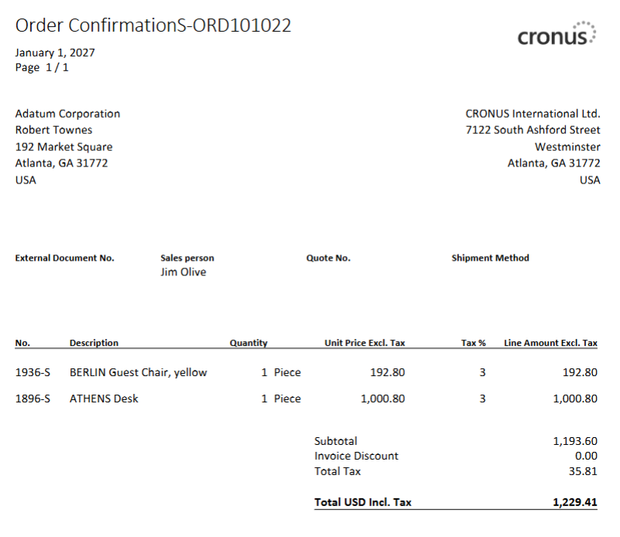

Slide 23
Tooltips now available on all reports (28.x)
Massive refactoring of all tables in the Business Central application

Slide 24
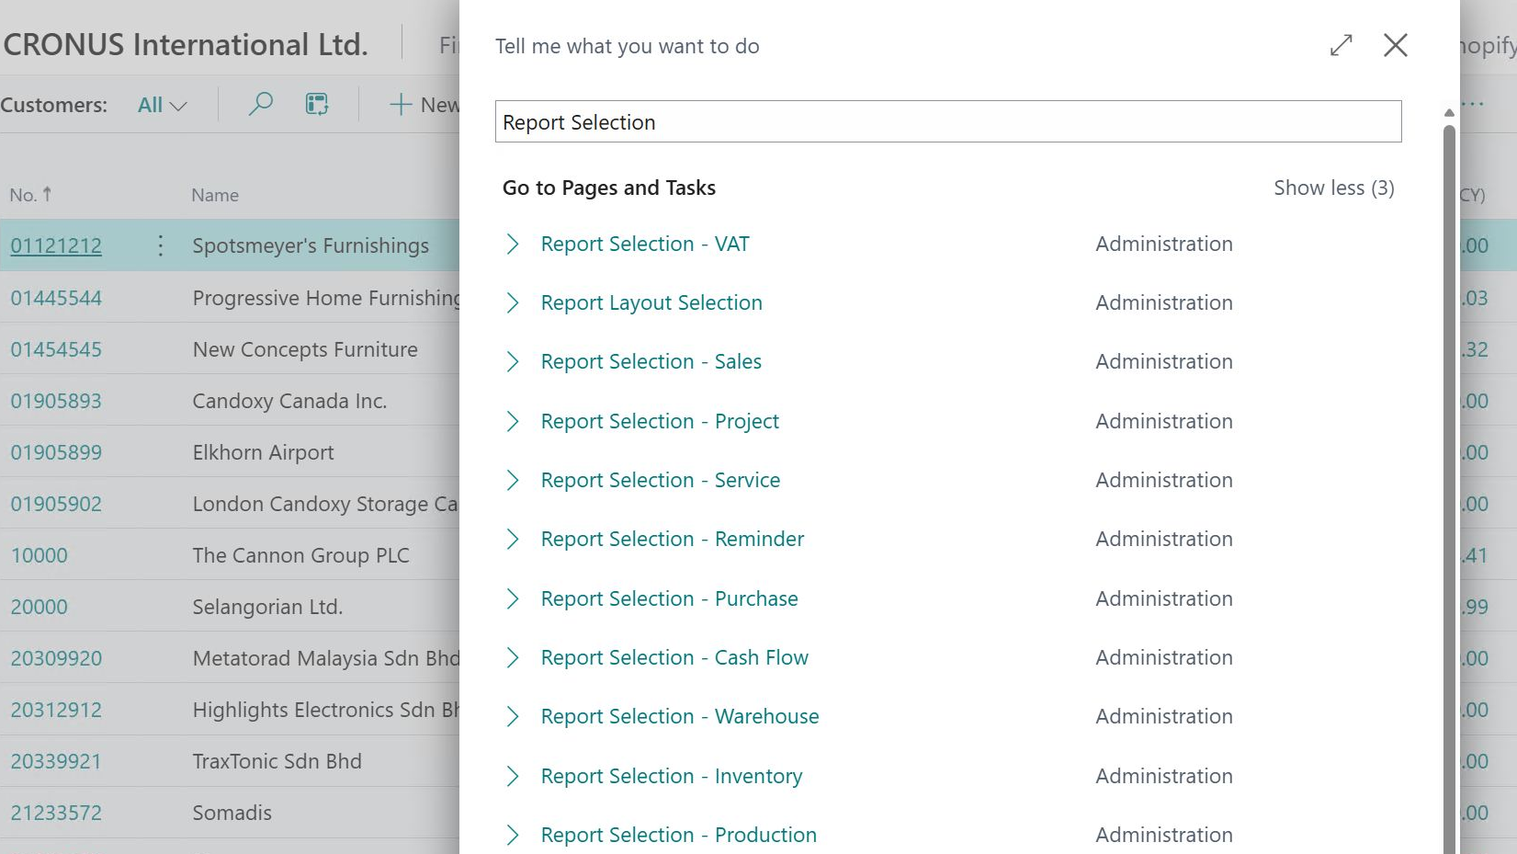
Modernization of report selection pages (28.x)
Added teaching tips
Aligned caption names and categories

Slide 25
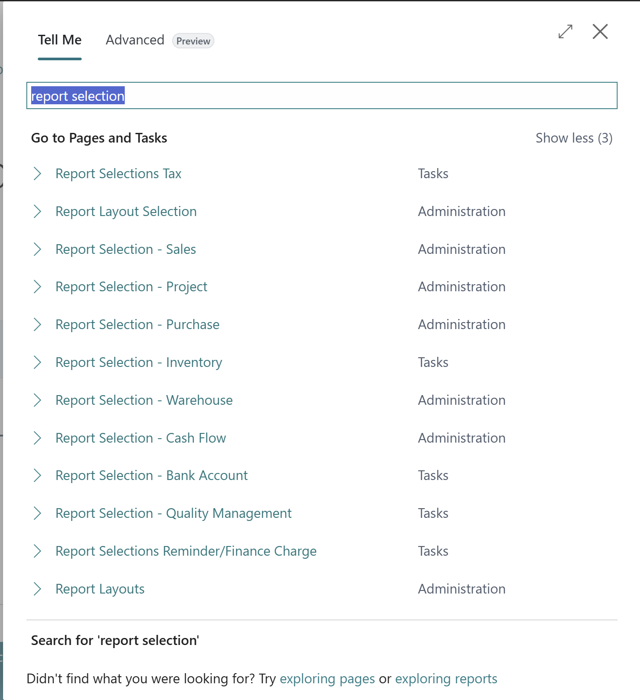
Notes:
2025w2

Slide 26
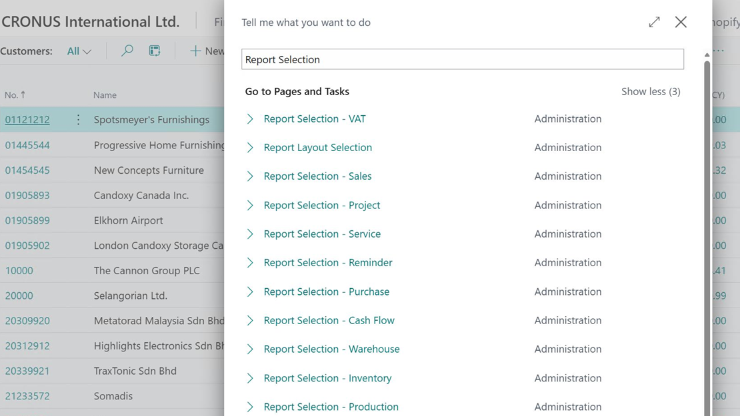

Slide 27
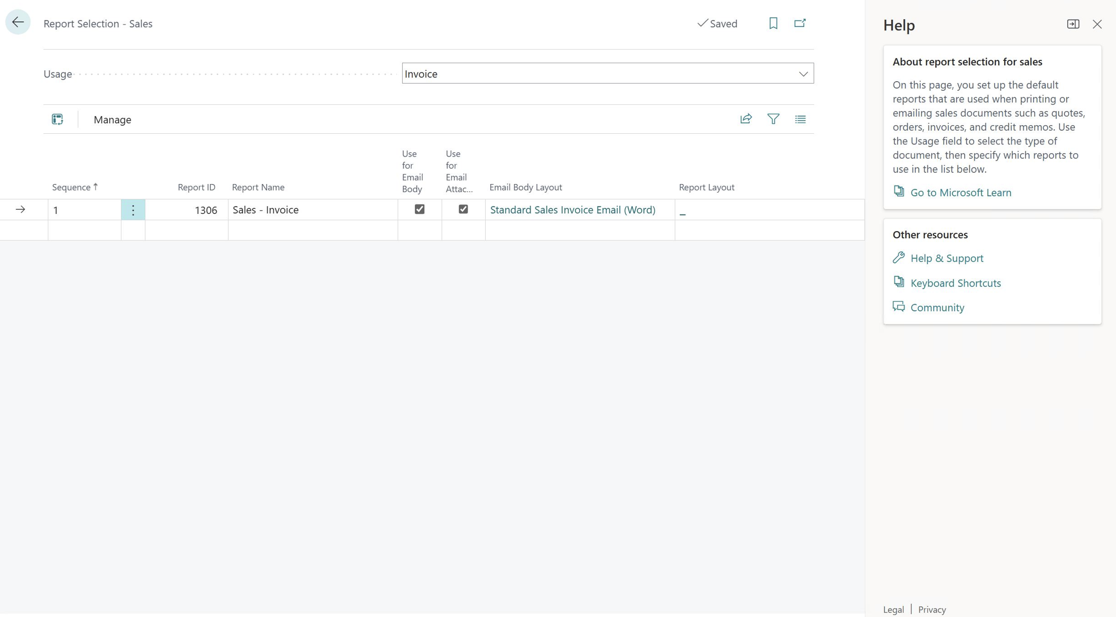

Slide 28
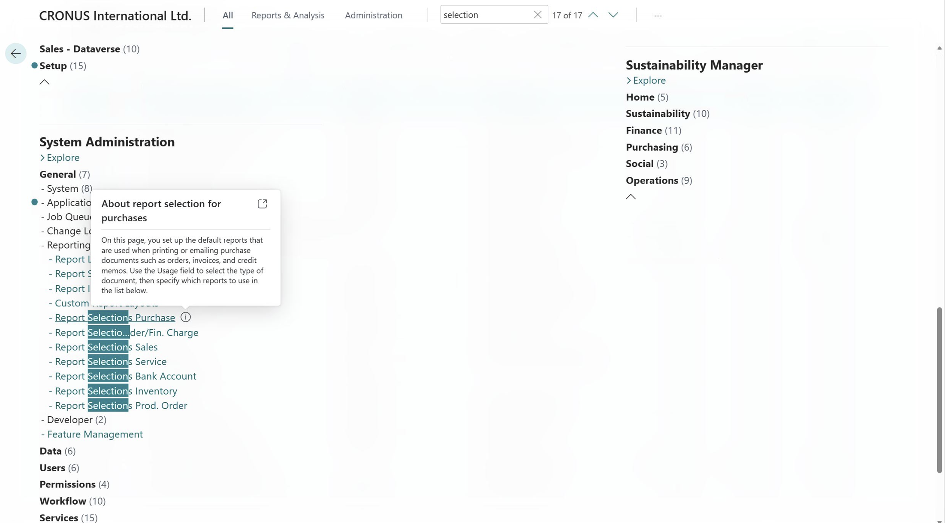

Slide 29
New PDF APIs for documents (28.x)
Purchase Quote
Blanket Sales Order
Sales Return Order
Sales Shipment
Return Receipt
Blanket Purchase Order
Purchase Receipt
Purchase Return Order
Purch. Return Shipment
Transfer Order
Transfer Shipment
Transfer Receipt
Sales Archive Quote
Sales Archive Order
Purchase Archive Quote
Purchase Archive Order
Sales Archive Return
Purchase Archive Return
Assembly Order
Posted Assembly Order
Sales Archive Blanket Order
Purchase Archive Blanket Order
Phys. Inventory Order
Posted Phys. Inventory Order
Phys. Inventory Recording
Posted Phys. Inventory Recording
Inventory Shipment
Inventory Receipt
Posted Inventory Shipment
Posted Inventory Receipt
Posted Direct Transfer
Before: 5 document types
Now: all 36 document types
Sales
Purchase
Inventory
Assembly
Notes:
Opens these areas up for Power Automate, Copilot Studio agents, and MCP server

Slide 30
Sales document types that now have PDF API
Blanket Sales Order
Sales Return Order
Sales Shipment
Return Receipt
Sales Archive Quote
Sales Archive Order
Sales Archive Return
Sales Archive Blanket Order

Slide 31
Purchase document types that now have PDF API
Purchase Quote
Blanket Purchase Order
Purchase Receipt
Purchase Return Order
Purch. Return Shipment
Purchase Archive Quote
Purchase Archive Order
Purchase Archive Return
Purchase Archive Blanket Order

Slide 32
Inventory document types that now have PDF API
Phys. Inventory Order
Posted Phys. Inventory Order
Phys. Inventory Recording
Posted Phys. Inventory Recording
Inventory Shipment
Inventory Receipt
Posted Inventory Shipment
Posted Inventory Receipt
Transfer Order
Transfer Shipment
Transfer Receipt
Posted Direct Transfer

Slide 33
Assembly document types that now have PDF API
Assembly Order
Posted Assembly Order

Slide 34
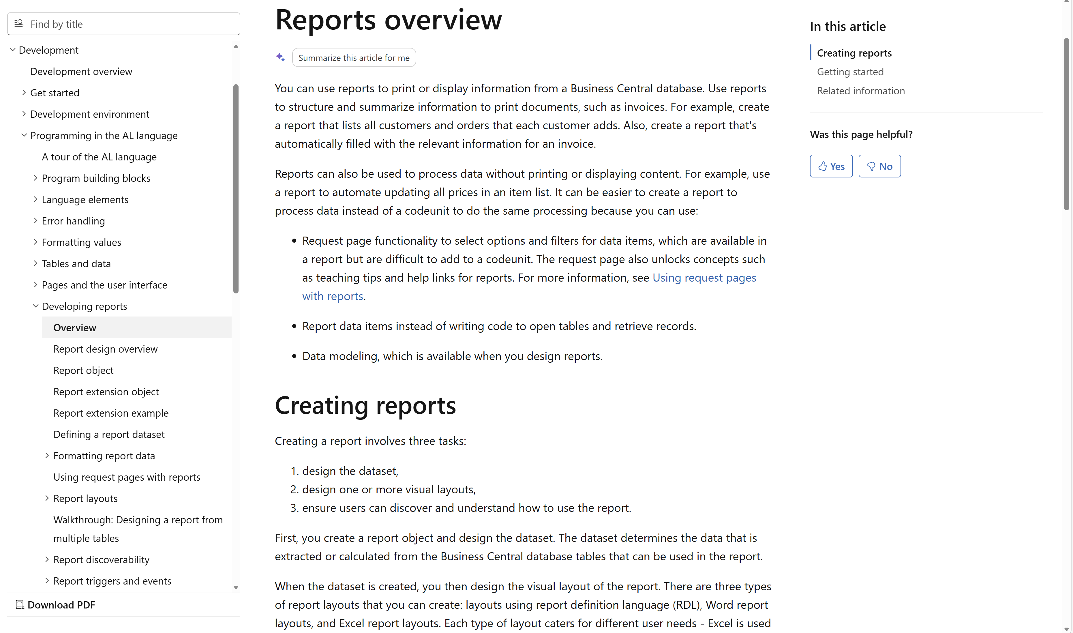
Want to learn more?
aka.ms/bcDeveloper
Notes:
Developing reports for Business Central
https://learn.microsoft.com/dynamics365/business-central/dev-itpro/developer/devenv-reports
About report layouts
https://learn.microsoft.com/dynamics365/business-central/ui-manage-report-layouts?toc=/dynamics365/business-central/dev-itpro/toc.json
Use the Word add-in for report layouts
https://learn.microsoft.com/dynamics365/business-central/dev-itpro/developer/word-layout-add-in

Slide 36
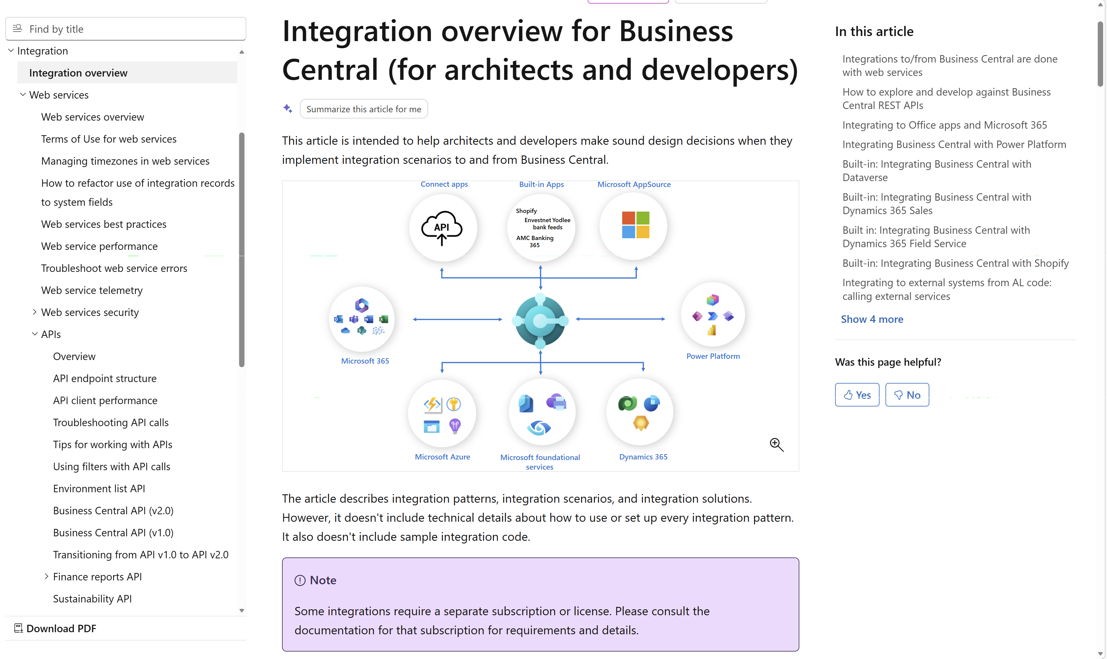
Want to learn more?
aka.ms/bcIntegration

Slide 38
Related sessions
What's new: Server and Database
What's new: APIs for permissions, approvals, and documents
What's new: Enhanced Power BI and Excel with Business Central

Slide 39
General Business Central resources
Learn more!
Looking for resources?
Watch more on YouTube
aka.ms/BCAll
aka.ms/BCYouTube
Join Viva Engage to ask questions
Follow on LinkedIn
aka.ms/BCLinkedIn
aka.ms/BCVivaEngage
Join the office hours
Microsoft page for partners
aka.ms/BCOfficeHours
aka.ms/BCPartnerPortal

Slide 40



LinkedIn
Follow the weekly news and announcements
on the Microsoft Dynamics 365 Business Central page
aka.ms/BCLinkedIn

Slide 41

Watch more videos on YouTube
One-stop shop to watch Business Central videos:
  What is new
  Copilot and AI
  Short tips and tricks
  Technical deep dives
  Under the Hood podcast series
aka.ms/BCYouTube

Slide 42
THANK YOU

